Slide 1

Cursor in MongoDB

Slide 2
Part I
We can consider the cursor as a pointer to the collection of documents, that is, as we call the db.find() function the cursor just iterates though the documents and helps output the result of the function. We will show how the cursor works by a example offered by the website.

Slide 3
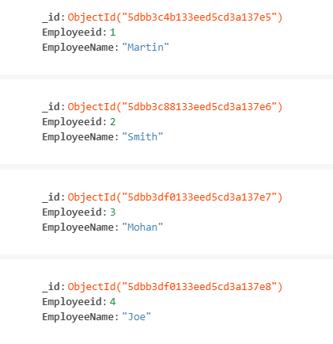
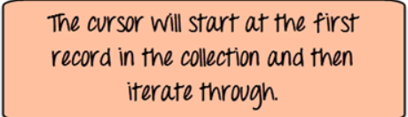
MongoDB Compass
MongoDB Compass is the GUI for MongoDB. It allows you to analyze and understand the contents of your data without formal knowledge of MongoDB query syntax.

Slide 4
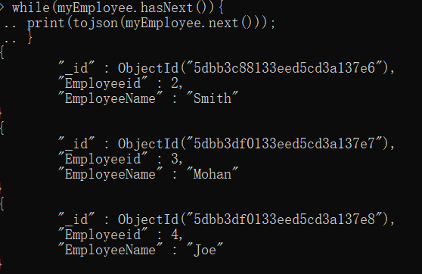
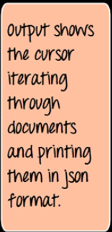

Slide 5
The “SQL” version of the code is like:
Select *
From Employee
Where Employeeid > 1

Slide 6
Part II
To show the example with six steps:
Install mongodb on EC2.
Verify the installation.
Denoramalize the instacart tables through MySQL Workbench.
Write a stored procedure to get json format data.
Use a command to upload data.
Check the uploaded data.

Slide 7
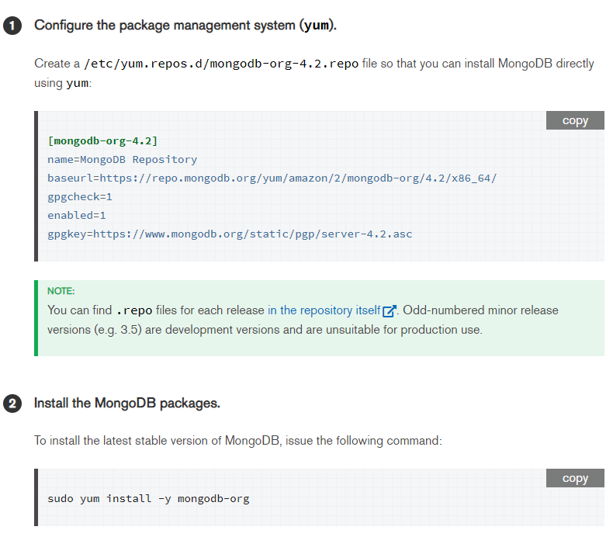
1. Install mongodb on EC2

Slide 8
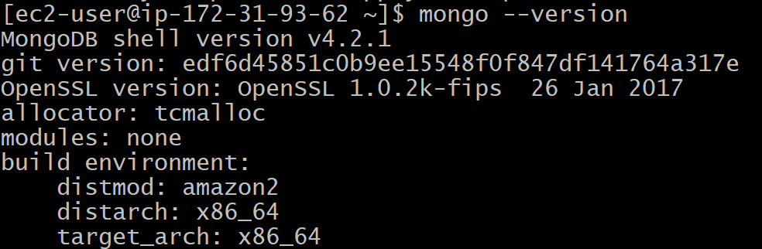
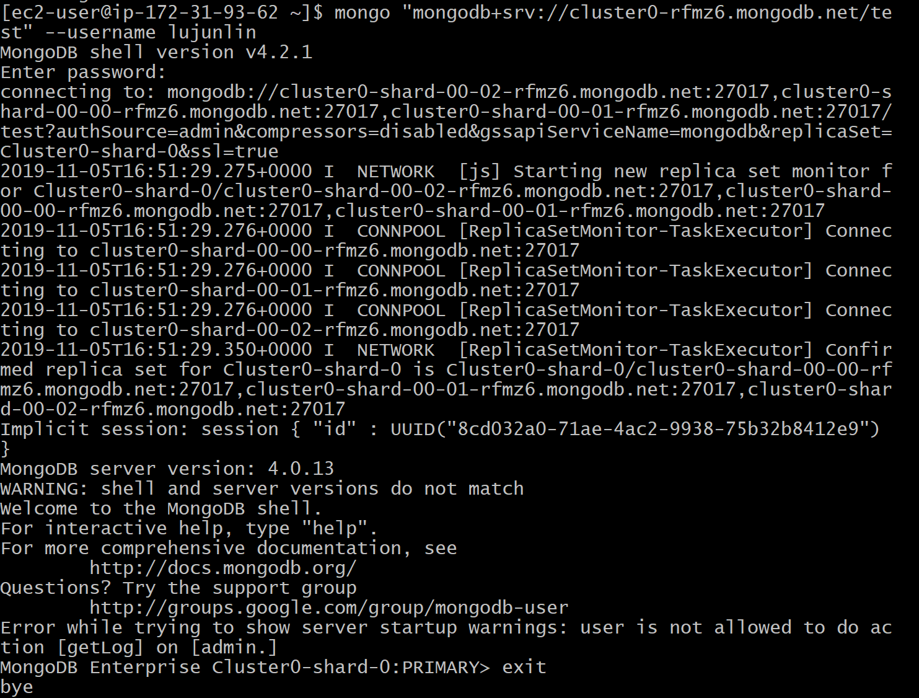
2. Make sure mongodb is installed and can access atlas from ec2

Slide 9
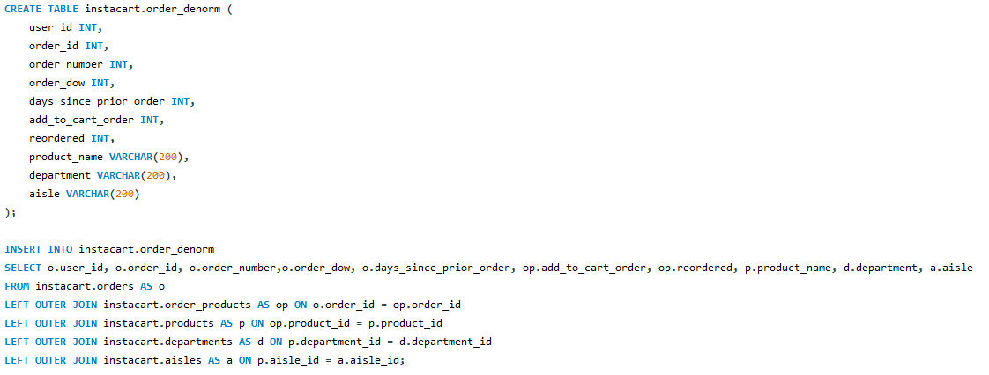
3. Denoramalize the instacart tables through MySQL Workbench.
According to the assignment, we need to denoramalize the instacart table.
Since our data is already on RDS, we can directly process it through MySQL Workbench.

Slide 10
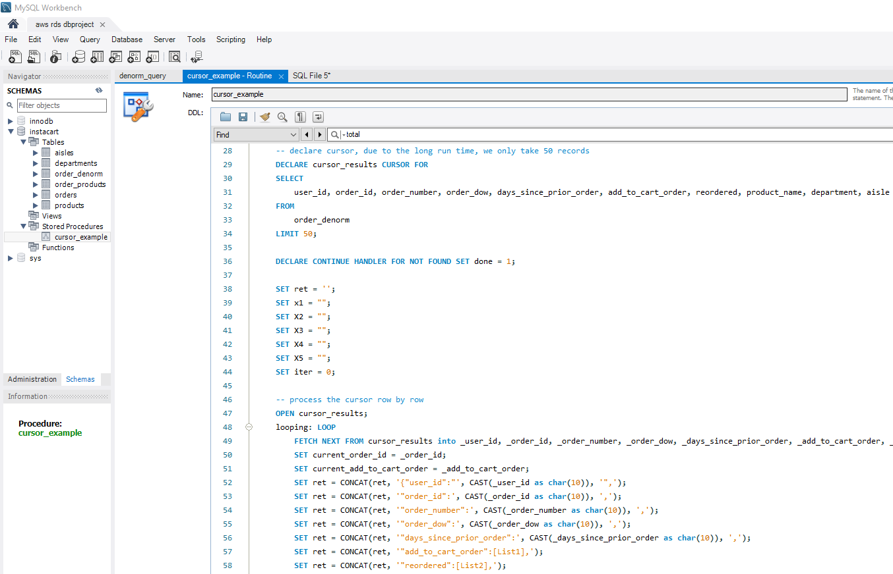
4. Write a stored procedure to get json format data.

Slide 11
5. Copy the order_denorm.json file to ec2, use the following command to upload data to mongodb
mongoimport --host cluster0-shard-00-02-rfmz6.mongodb.net:27017
--db instacart --type json
--file /tmp/order_denorm.json
--jsonArray
--authenticationDatabase admin
--ssl
--username lujunlin --password

Slide 12
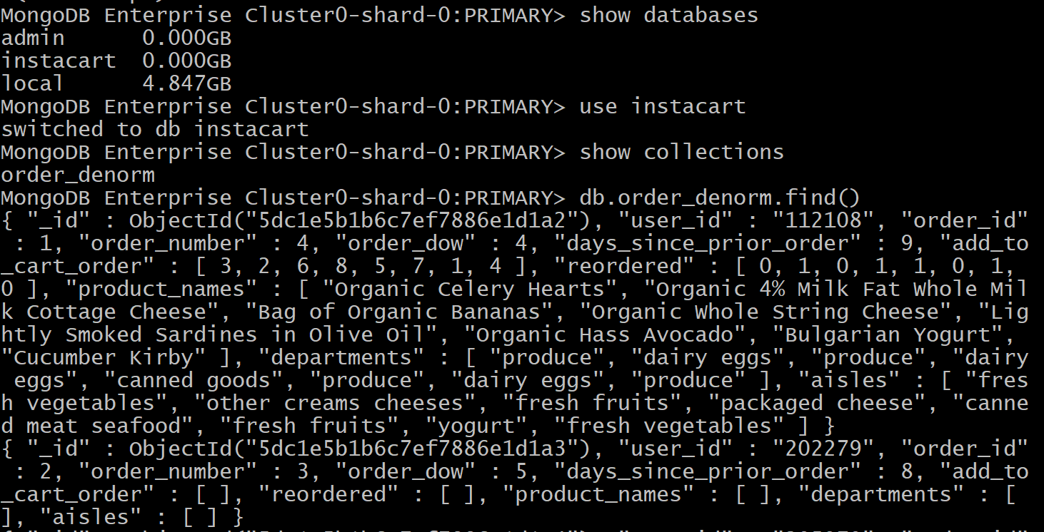
6. Make sure the data is on mongodb

